Slide 1

Analyzing Automobile Engine Impact on MPG
INTRODUCTION TO DATA SCIENCE
FINAL PROJECT
By Rableen Kaur Kapoor

Slide 2
Project Objectives and Dataset Overview
Objective: Analyze the relationship between engine factors and MPG using statistical methods.
Dataset: auto-mpg.csv (398 rows, 9 columns).
Key Features: MPG, Cylinders, Displacement, Horsepower, Weight, Acceleration, Model Year, Origin, Car Name.
Approach: Data exploration, linear regression, model validation, visualizations.

Slide 3
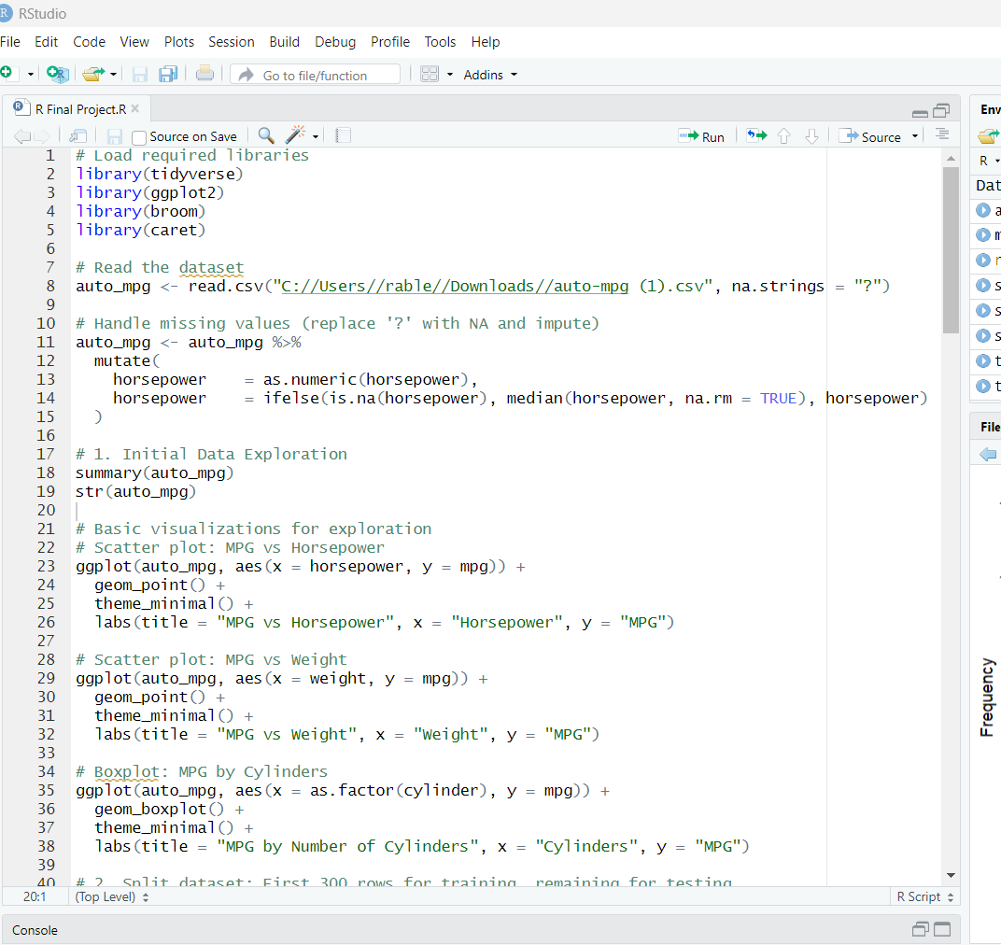
R CODE

Slide 4
Data Exploration: Summary Statistics
Dataset Size: 398 rows, 9 columns.MPG Range: 9–46.6 (Mean: 23.5).
Horsepower Range: 46–230 (Mean: 104.5).
Weight Range: 1613–5140 lbs (Mean: 2970.4).
Missing Values: Handled in horsepower (replaced with median).

Slide 5
Data Exploration: Visualizations
Scatter Plot: MPG vs. Horsepower (negative correlation).
Scatter Plot: MPG vs. Weight (strong negative correlation).
Boxplot: MPG by Number of Cylinders (fewer cylinders, higher MPG).

Slide 6
Simple Linear Regression: MPG vs. Horsepower
Model: MPG = β₀ + β₁ * Horsepower
Data: First 300 rows (training set).
R Code: lm(mpg ~ horsepower, data = train_data)

Slide 7
Multiple Linear Regression: MPG vs. Multiple Features
Model: MPG = β₀ + β₁ * Cylinders + β₂ * Displacement + β₃ * Horsepower + β₄ * Weight + β₅ * Acceleration + β₆ * Model Year + β₇ * Origin
Data: First 300 rows (training set).
R Code: lm(mpg ~ cylinder + displacement + horsepower + weight + acceleration + model.year + origin, data = train_data)

Slide 8
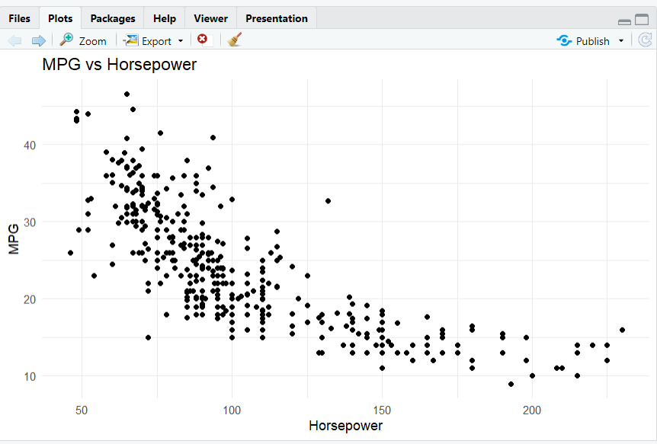
Scatter Plot: MPG vs Horsepower in R Studio

Slide 9
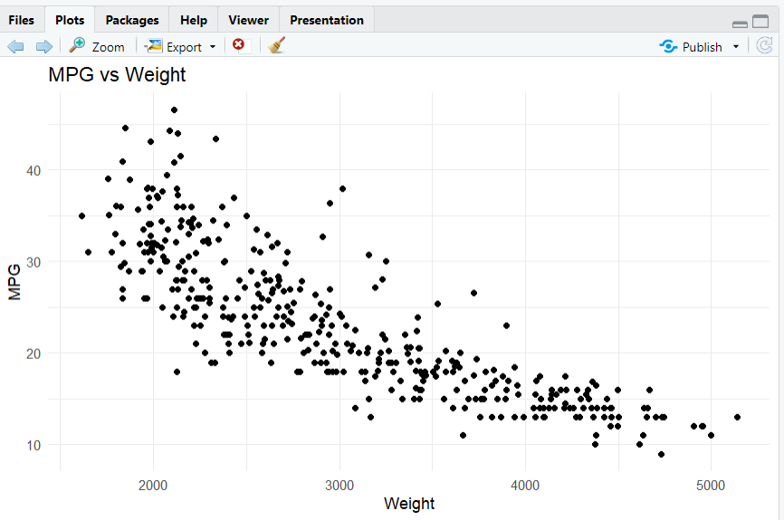
Scatter Plot: MPG vs Weight in R Studio

Slide 10
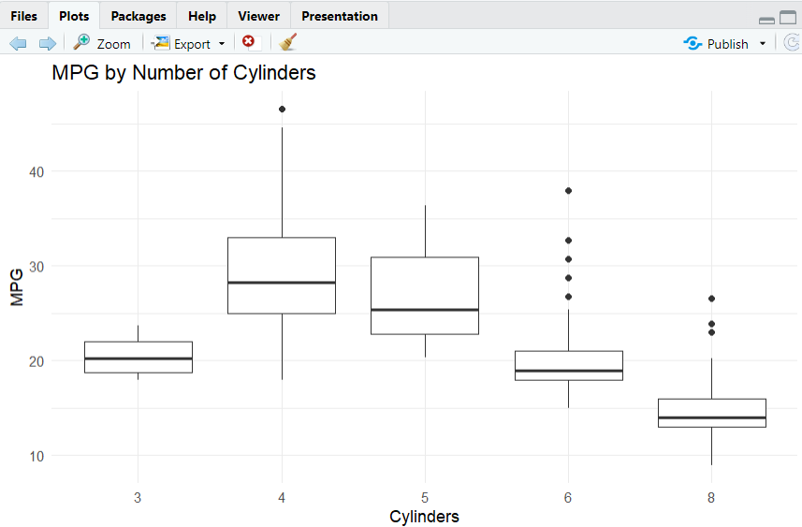
Box Plot: MPG vs Number of Cylinders in R Studio

Slide 11
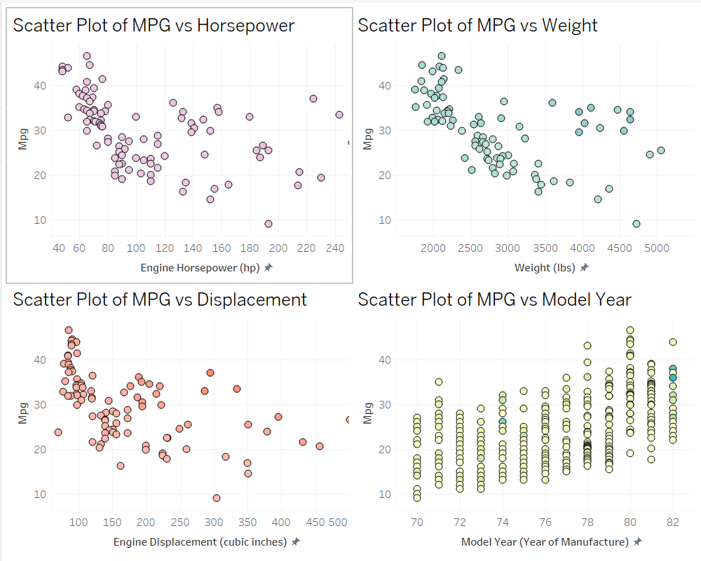
Automobile Dataset using TABLEAU

Slide 12
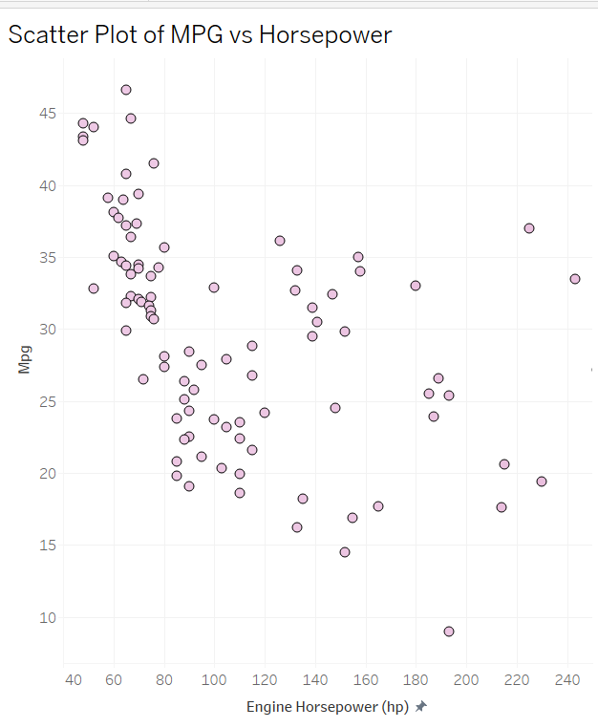
Scatter Plot of MPG vs Horsepower In Tableau

Slide 13
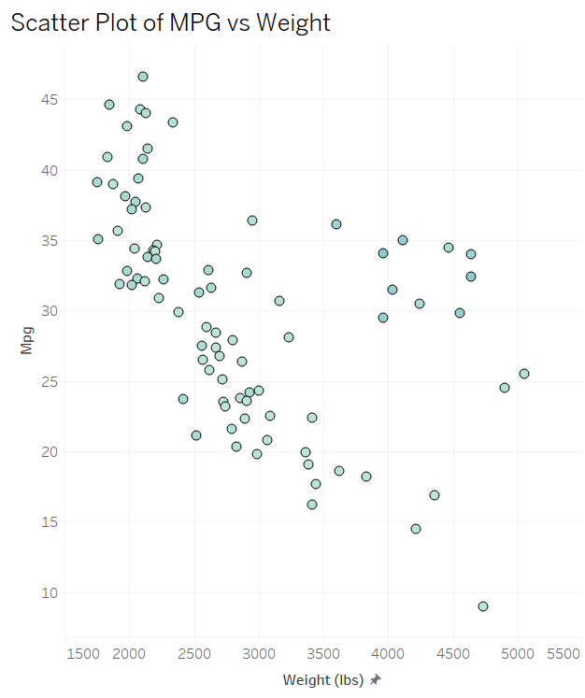
Scatter Plot of MPG vs Weight in Tableau

Slide 14
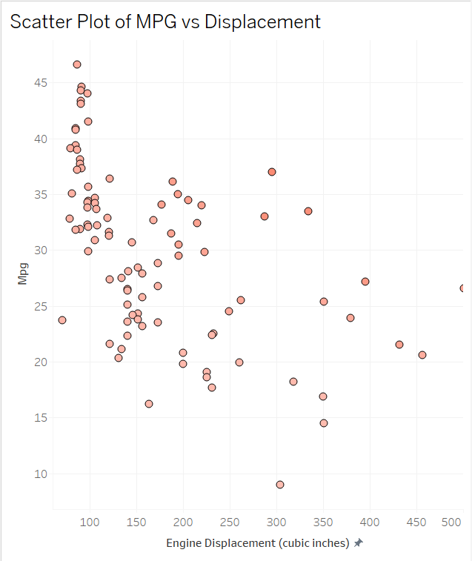
Scatter Plot of MPG vs Displacement in Tableau

Slide 15
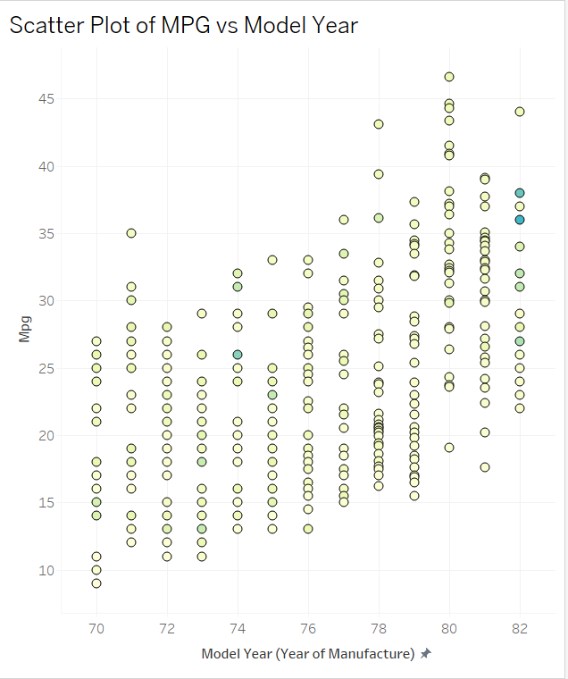
Scatter Plot of MPG vs Model Year in Tableau

Slide 16
R Code Explanation: Data Preparation and Modeling
Libraries: tidyverse, ggplot2, broom, caret.
Data Cleaning: Replaced missing horsepower values with median.
Data Splitting: 300 rows for training, 98 for testing.
Modeling: Simple and multiple linear regression using lm().
Metrics Logging: Stored R-squared, equations in a data frame.

Slide 17
R Code Explanation: Predictions and Visualizations
Predictions: Used predict() on test data with multiple linear model.
Validation Metrics: Calculated RMSE and MAE.
Visualizations: Residual plot and histogram using ggplot2.
Export: Saved plots as PNGs for PowerPoint/Tableau, metrics as CSVs.

Slide 18
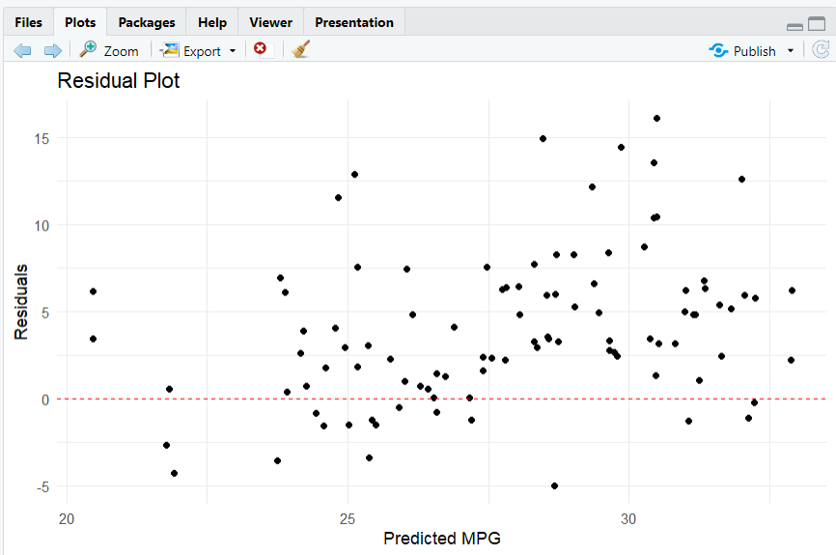
Residual Plot using R Studio

Slide 19
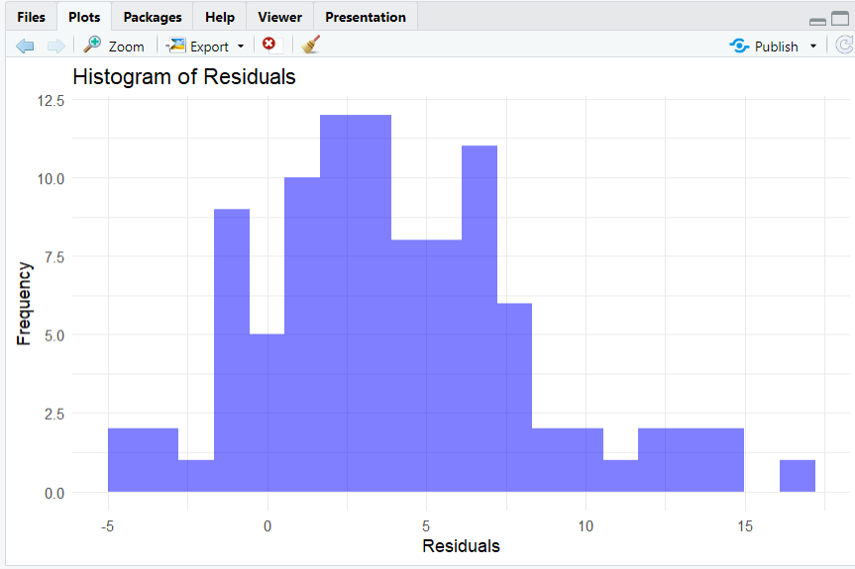
Histogram of Residuals using R Studio

Slide 20
Key Findings and Insights
Weight and horsepower are the strongest negative predictors of MPG.
Later model years and non-US origins (Europe, Japan) improve MPG.
Multiple linear regression outperforms simple regression.
Model predicts test data with RMSE and MAE.

Slide 21
Conclusion
Successfully built and validated linear regression models to predict MPG.
Multiple regression provides better explanatory power than simple regression.
Key drivers of MPG: Low weight, low horsepower, recent model years, non-US origin.
Limitations: Some residuals indicate potential outliers; model could be enhanced with nonlinear methods.
Visual: Image of a fuel-efficient car or a checkmark icon.

Slide 22

Recommendations
Manufacturers: Focus on reducing vehicle weight and optimizing horsepower.
Consumers: Prioritize cars from Japan/Europe or newer models for better MPG.
Future Work: Explore nonlinear models, additional features, or larger datasets.
Thank You!

